Slide 1
Platform Supply Vessel Logistics
Venkata Praveen Naradasu
Sai Mahesh Boppana

Slide 2
Agenda:
Introduction and Problem Statement
Assumptions and Scope
Objective and Constraints
Input Data Analysis
Model Concept
Discussion on Model,objects,Data,State Variables,Tally Stats
Experimentation on Opt Quest
Results
Future constraints and discussion

Slide 3
Introduction

Slide 4
Simio Supply Logistics (SSL) is an organization that charters offshore vessels to and from various offshore drilling locations. SSL can choose from a variety of watercraft to rent monthly. The collection of platform supply vessels (PSVs) is selected and dispatched out of ports. These vessels service four deep-water rigs. The system is presently under scrutiny due to high costs, unmet demand, and excessive standby time.

Slide 5
Current Scope:
Considered 2 ports,3 vessel types to serve 4 rigs orders
Vessel Speed variations based on weather conditions
Loading and unloading times of orders based on material type
Ships carrying only one order at a time - Capacity
Cost calculations - Ship daily costs, Usage Costs,Penalty Costs
Notes:
We are currently considering only 2 ports, study of 3rd port is not done as of now, We added in an event to consider the weather pattern change every 30 min and updating the vessel speeds accordingly at all the node exits Vehicle loading and unloading times based on material type and quantity are calculated We are not looking at the possibility of combining multiple orders into in single shipment (Future scope)

Slide 6
Assumptions
All the rigs follow same discrete distribution in the quantities of each material
Only one kind of vessel type is used at any given time in the system
Bundles are considered to be 1 unit for certain material types (Load in,Load out)
Alpha and Beta Rigs served by Rotterdam and Charlie and Delta Rigs served by Hamburg port
Notes:
Pipes and Casing

Slide 7
Objective:
Minimize (Vessel cost + Penalty due to order delay)
Increases with the number of vessels deported at each port and type of vessels used.
Can be decreased by increasing faster deliveries using better vessel type which in turn increases the Vessel costs

Slide 8
Constraints
Slips at each port
Vessel Speeds
Penalty

Slide 9
Input Data

Slide 10
Order Frequency of each Rig:
Rig | Interarrival
Alpha | Random.exponential(9.37)
Beta | Random.exponential(5.87)
Charlie | Random.exponential(6.24)
Delta | Random.exponential(7.01)

Slide 11
Material Properties:
MaterialTypes | Load_UnloadTimeperUnit | UnitSize | OrderQuant
DeckCargo | 10 | 1 | Random.Discrete(5,0.32,7,0.75,32,0.843,68,0.92,57,0.98,9,1 )
Casing | 13 | 1 | Random.Discrete(9,0.34,20,0.74,12,1)
DryBulk | 60 | 2500 | Random.Discrete(1600,0.01,1700,0.02444,...1))
Fuel | 60 | 2000 | Random.Discrete(1000,0.00136,....1)
LiquidBulk | 60 | 3000 | Random.Discrete(1000,0.004,....1)
Pipe | 15 | 1 | Random.Discrete(5,0.237,18,0.585,40,0.631,12,0.900,50,0.95,60,1)

Slide 12
Model Concept

Slide 13
Model Components:
4 Model entities
AlphaRigOrders,BetaRigOrders,CharlieRigOrders and DeltaRigOrders
4 Sources
Each one for the above with arrival rates from previous tables
2 Servers
Representing Ports RotterDam and Hamburg.
4 Sinks
Alpha,Beta,Charlie and Delta
8 Servers for waypoints with 0 service times
1 Entity,1 Source and 1 sink for Weather calculations

Slide 14
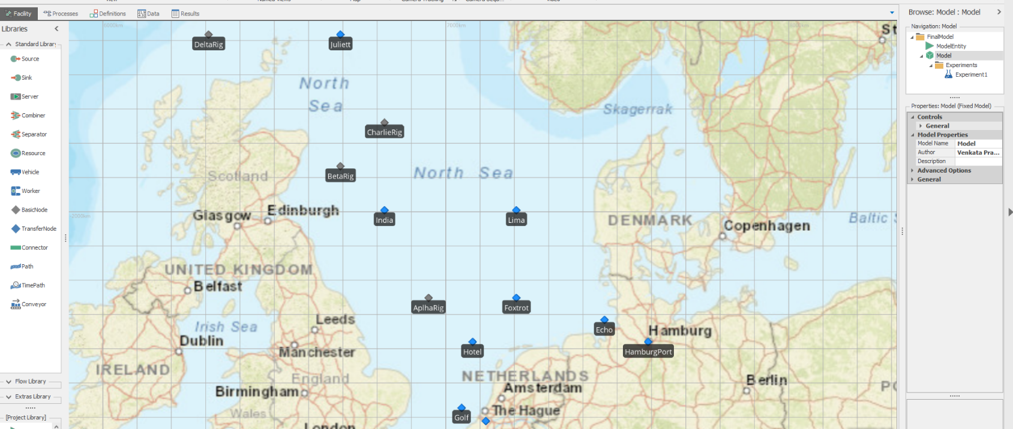

Slide 15
State Variables:
ModelEntity.OrderDate
ModelEntity.Material
ModelEntity.Quantity
ModelEntity.Load_UnloadTimes
ModelEntity.TotalDeliveryTime
Tally Stats: {Rig}LateDeliveries,{Rig}LateTimes
Properties: (Variables)
VesselType
NumofShipsatHamburg
NumofShipsatRotterDam

Slide 16
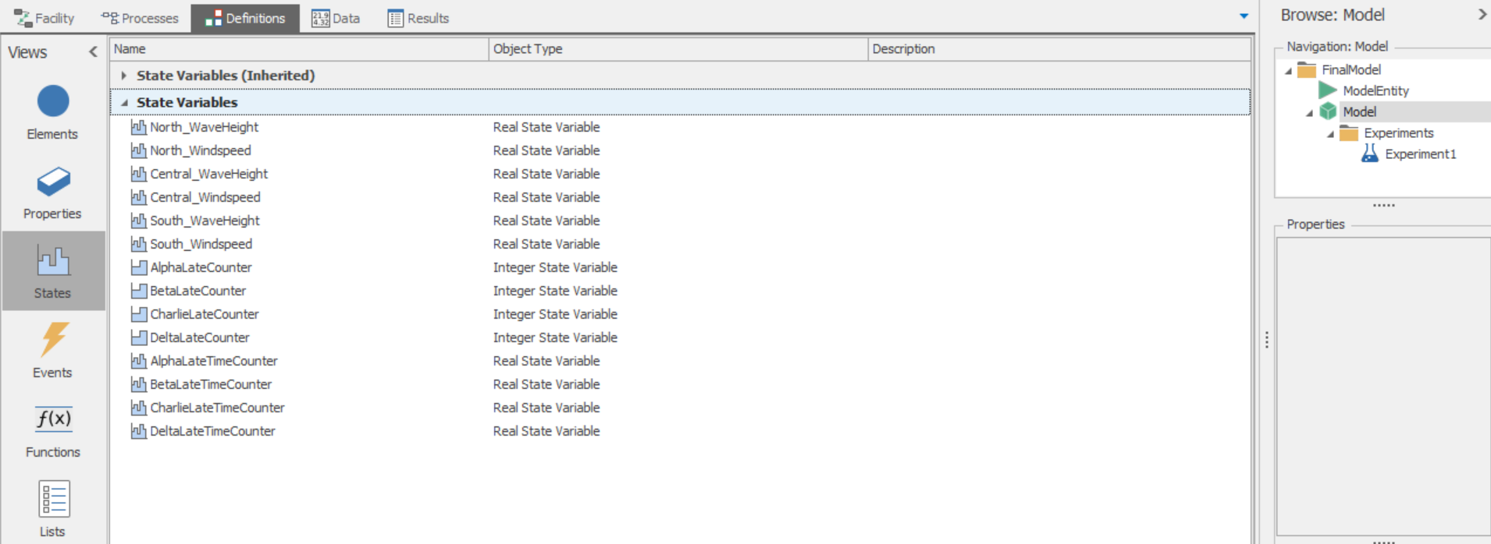

Slide 17
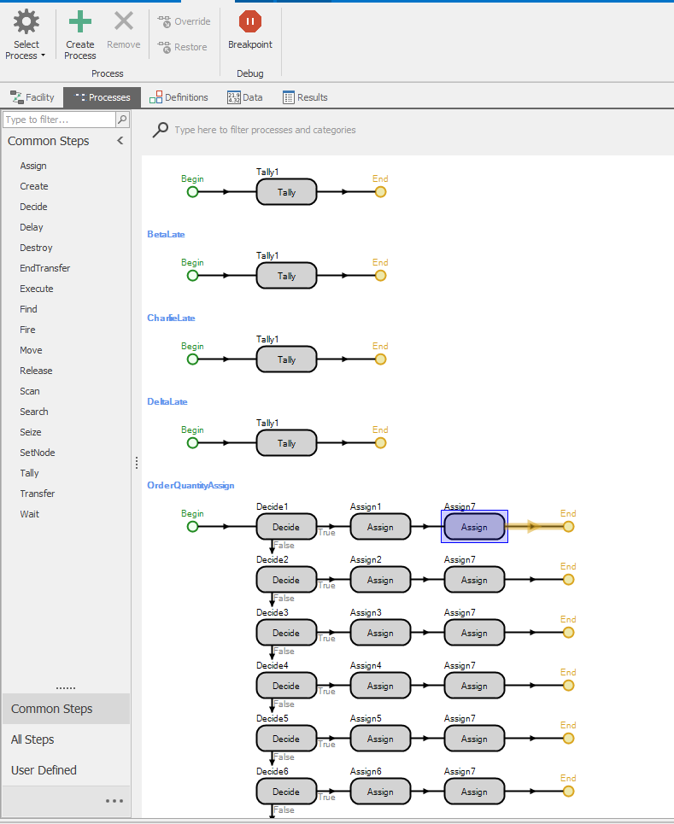
To calculate the tally stats at all the rigs to obtain number of late deliveries and sum of late times
To assign order quantities and calculate load in and load times for each entity

Slide 18
Experiment

Slide 19
Responses: Count of Late Deliveries at each rig.
How delayed each late delivery is? Penalty = 240000*DelayedTime in Days
Total Cost=Penalty+Ship expenses
OptQuest:
Objective = Max(TotalCostFunc)
Variables: Vessel Type (1,2&3)
Vessel Counts at each port: [20,70] increments of 10
Warm up period: 30 days
Run Time: 365 days
Confidence level: 95%
Min and max replicas: 10,20
Max scenarios: 300
Notes:
Pipes and Casing

Slide 20
Results:
A minimal cost is obtained by employing vessel type 9000 by having 30 at Hamburg port and 40 at Rotterdam Port
Note: Capacity constraint is not added here hence its decision is solely dependent on Speed and Cost of usage.

Slide 21
Future Scope and Constraints:
Analysis on combination of vehicles (For this model)
Capacity constraint
Dwell times for fueling conditions
Cost calculations that includes Slip usage cost
Analysis on metrics by adding a new port and its impact on penalty functions

Slide 22
Thanks!
Please keep this slide for attribution

